Slide 1
CodePath
Week 7
CS 4760 F18
Christopher Raley

Slide 2
Codepath Homework
Lab report 10/21 @ 11:59 PM
Penetration Testing with WordPress
Submitted on Collab
This includes submitting the assignment on CodePath in “Assignment”

Slide 3
PHP
SQLI
XSS
Clickjacking
Session Hijacking
Other attacks
Topics
Week 7
Readings on course website

Slide 4
Installation
VirtualBox
You also need the Extension Pack as well
Make sure that the versions of VirtualBox are the same
Vagrant
Vagrant plugin: vagrant-hostsupdater

Slide 5
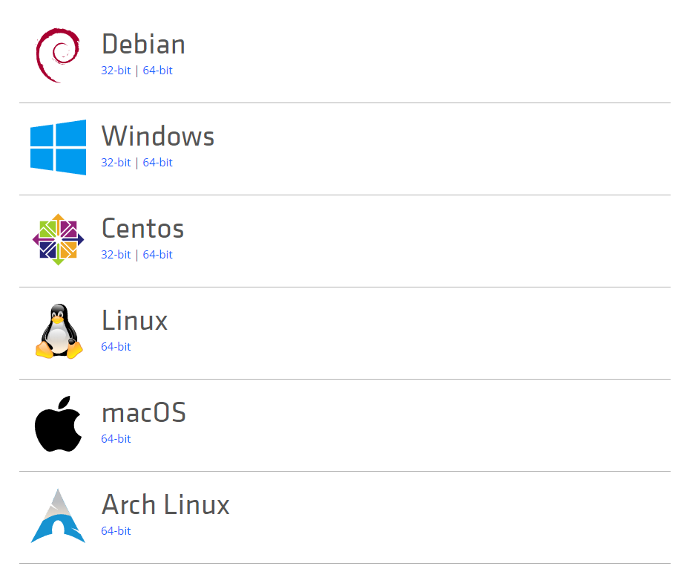
Vagrant
Allows scripting of VM creations
Running “vagrant up” can take a bit of time (~5 min)

Slide 6
Installation Notes
You are going to be installing the following on your host machine
VirtualBox w/ Extension Pack
Vagrant
WPDistillery

Slide 7
Installation
WPDistillery
Establishes WordPress pentesting environment
Use Git to clone via Command Prompt/Terminal
https://github.com/flurinduerst/WPDistillery

Slide 8
Important Notes
Necessary to read through everything on the CodePath website carefully
Start early, some of you will encounter technical difficulties
Windows users must run everything as an administrator
Document as you go
In case you make a mistake

Slide 9
Important Notes
If you plan on using the course’s copy of Kali…
You need to run: apt-key adv --keyserver hkp://keys.gnupg.net --recv-keys 7D8D0BF6

Slide 10
Important Notes
If you plan on using the course’s copy of Kali…
apt-get update && apt-get upgrade
This will take some time
https://guides.codepath.com/websecurity/Running-Kali-Linux-in-VirtualBox

Slide 11
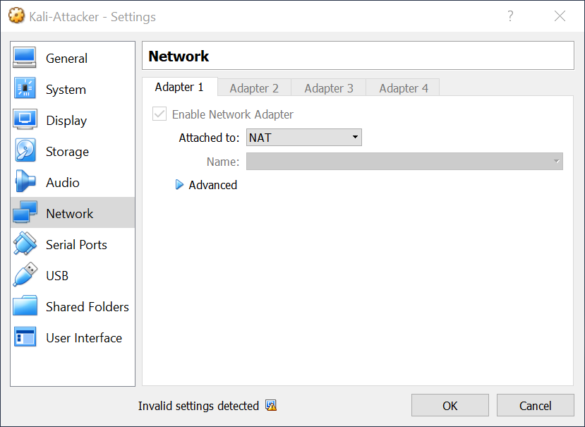
Important Notes
If you plan on using the course’s copy of Kali…

Slide 12
Lab Report
Walkthrough of Challenge 7 in the Lab
The lab serves as a prerequisite for the assignment
Make sure to submit a PDF in the format as described in the write-up
Try and solve all technical issues you encounter (make sure to document these)

Slide 13
CodePath Assignment Submission
Following the submission guidelines
https://courses.codepath.com/courses/cybersecurity_university/pages/submitting_assignments
You need to create a public repo with your GitHub account you used to sign up for CodePath
Read all directions/requirements carefully

Slide 14
Office Hours
Monday / Thursday / Sunday : 5 - 7 PM @ Rice 226

